Slide 1



SMART INDIA
HACKATHON 2026
TITLE PAGE
Problem Statement ID – SIH26045
Problem Statement Title- IP-SAKTI Sahayak a multilingual AI assistant
Theme- MedTech/BioTech/HealthTech
PS Category- Software
Team ID- 125796
Team Name - SIH BEGINNERS

Slide 2
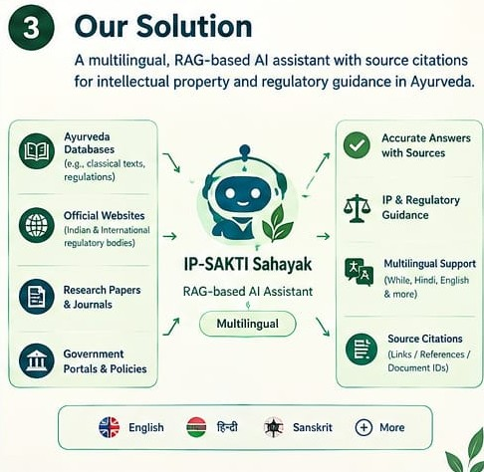
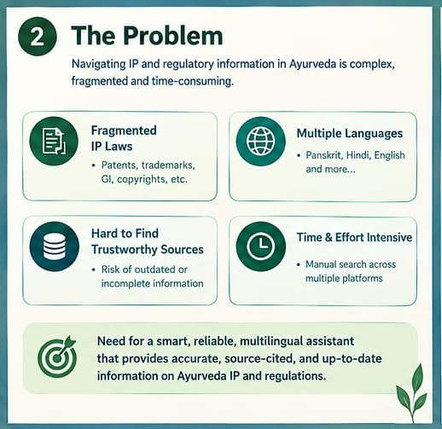
SIH
Beginners
PROPOSED SOLUTION

Slide 3
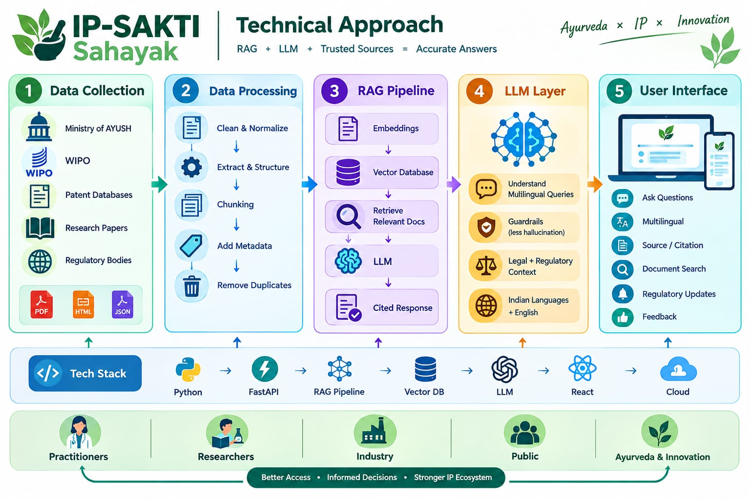
SIH
Beginners
TECHNICAL APPROACH
4

Slide 4
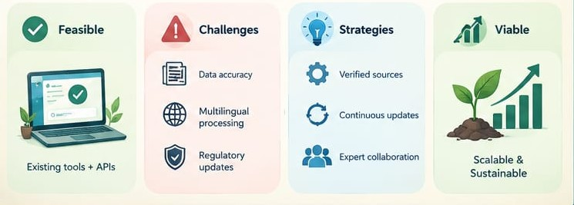
SIH
Beginners
FEASIBILITY & VIABILITY
PHASE 1
MVP
Citation-grounded RAG + core corpus + Dashboard + classifier
PHASE 2
SMARTER
Knowledge Graph
+ ABS/TK + routing + confidence
PHASE 3
REACH
Multilingual + voice + international jurisdiction packs
PHASE 4
SCALE
Continuous updates + security + evaluation + deployment

Slide 5

SIH
Beginners
IMPACT & BENEFITS
FIND
Reduce time spent locating relevant information
TRACE
Keep evidence attached to AI responses
Protect
Improve awareness of IP, TK and ABS considerations.
UNDERSTAND
Make complex IP / regularity pathways easier to navigate
ACCESS
Broden access through multilingual + voice interaction
A practical decision-support layer for the AYUSH innovation ecosystem
Core principle : Help users move from an idea to a clearer, evidence-backed pathways –while keeping professional review in the loop.

Slide 6

SIH
Beginners
RESEARCH & REFERENCES
References / Research
Ministry of Ayush & CDSCO websites.
WIPO, WHO, FDA, EMA resources.
Ayurveda research papers & journals
Government policies and IP databases
1. LOGIN
2. DASHBOARD
3. ASK
4. CLASSIFY
5. IP PATHWAY
6.ABS/TK
7. SOURCES
8. VOICE
Live Prototype Demo
Recommended 2-3 judge walkthrough
“ From an Ayurveda idea → to a guided , source-cited IP & regularity pathway.”
https://github.com/gyanendraakshatriya/SIH-
IP- SHAKTI SAHAYAK – SIH26045

